Slide 1
Airport Management System
Presented By:
Name : Abdullah As Sami
ID : 1704111
Supervised By
Md Shafiul Alam Forhad
Assistant Professor
Department of CSE,CUET
Md Atiqul Islam Rizvi
Lecturer
Department of CSE,CUET

Slide 2


Contents
Introduction
We used DBMS in airport management system . First of all, we need to identify the entities, attribute and relationships. When we use DBMS , the record of all airport management entities is in the same location. We shows entities, attributes and relationships by ER diagram. SQL is a language which is used for applying queries.

Slide 3

Motivation
Huge number of passanger gather in airport to travel or to reserve ticket . Simmilarly many airline agency conduct their policy strictly . Most of the time it is seen that flight schedule collapase due to weather calamities. Flight fare ,Plane company ,flight availability and many other things are needed to know for a passenger . Here a database can reduce the sufferings.
Huge number of passenger gather in airport to travel or to reserve ticket . Similarly many airline agency conduct their policy strictly . Most of the time it is seen that flight schedule collapse due to weather calamities. Flight fare ,Plane company , flight availability and many other things are needed to know for a passenger . A database management system can reduce this sufferings.

Slide 4

Objectives
To make a project on Airport management system using SQL, java, Netbeans and making the airport database more advanced .
It can help passenger ,employee as they can find the proper information .

Slide 5
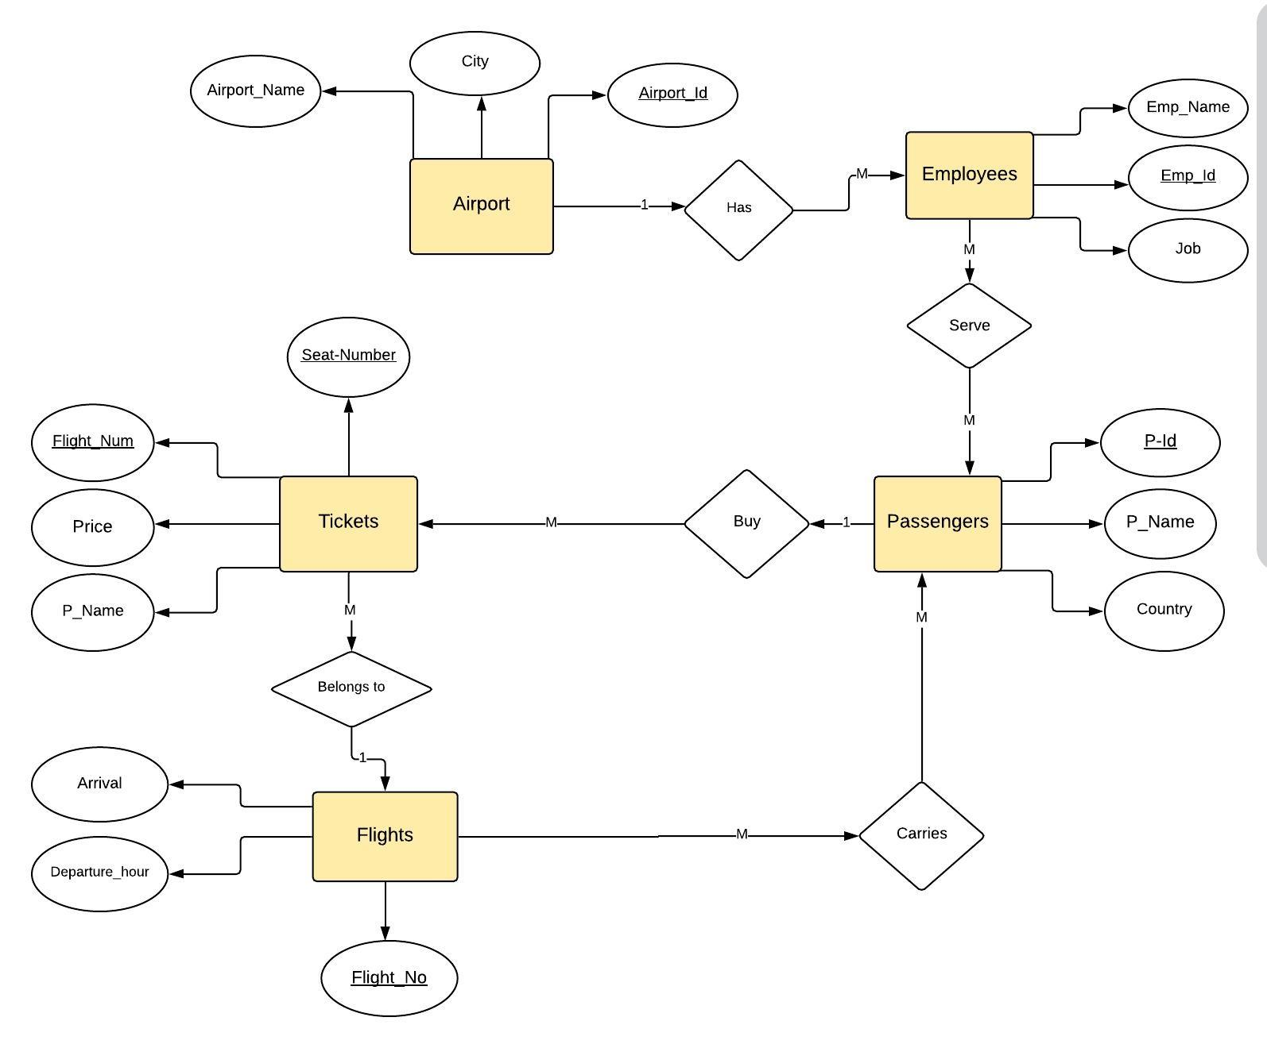
Proposed Methodology (ER Diagram)

Slide 6
Relational Mapping
Airport
Air_id
Air_Name
city
Employee
Emp_name
Emp_id
job
Air_id
serve
Emp_Id
Passenger_id
Passenger
P_id
P_Name
Country
Carries
P_Id
Flight_No
Flights
Arrival
Departure_hour
Flight_No
Ticket
T_Num
Price
P_Id
Flight_No
P_Name

Slide 7
Normalized Form(1NF)
Airport
Air_id
Air_Name
city
Employee
Emp_name
Emp_id
job
Air_id
serve
Emp_Id
Passenger_id
Passenger
P_id
P_Name
Country
Carries
P_Id
Flight_No
Flights
Arrival
Departure_hour
Flight_No
Ticket
T_Num
Price
P_Id
Flight_No
P_Name

Slide 8
Normalized Form(2NF)
Airport
Air_id
Air_Name
city
Employee
Emp_name
Emp_id
job
Air_id
serve
Emp_Id
Passenger_id
Passenger
P_id
P_Name
Country
Carries
P_Id
Flight_No
Flights
Arrival
Departure_hour
Flight_No
Ticket
T_Num
Price
P_Id
Flight_No
P_Name

Slide 9
Normalized Form(3NF)
Airport
Air_id
Air_Name
city
Employee
Emp_name
Emp_id
job
Air_id
serve
Emp_Id
Passenger_id
Passenger
P_id
P_Name
Country
Carries
P_Id
Flight_No
Flights
Arrival
Departure_hour
Flight_No
Ticket
T_Num
Price
P_Id
Flight_No
P_Name

Slide 10
Conclusion
Airport management process is highly complex system . though it can operate through a proper database which can be able to reduce the problems of airport , air traffic and passengers .

Slide 11


